Slide 1
COP3514 Program Design
Fall 2023
Instructor: Dr. Jing Wang

Slide 2
About me
Jing Wang, Ph.D., Professor of Instruction
My research areas are computer animation and computing education
My current hobbies and interests: reading, mentoring, gardening, swimming

Slide 3
Today’s topics
Syllabus
Unix/Linux accounts on student cluster
Introduction to Unix
Chapter 2: C Fundamentals
Getting ready for the semester

Slide 4
Syllabus

Slide 5
What would you learn from this course?
Better at problem solving
Design a program of moderate complexity as multiple small, easily understood functions and modules
Write defensive code to detect program errors
Build a solid foundation of knowledge in data structures and algorithms

Slide 6
Lecture Structure
Concepts
Live coding examples
In-class multiple choice questions
In-class programming exercises
Work individually or in groups: guided by TA/instructor
Complete the exercises by next class
Solution will be posted by Friday the same week

Slide 7
Prerequisite
Programming Concepts (COP2510) or equivalent
Variables and expressions
Conditional statement
Loops
Arrays
Basic understanding of method/function
We will still cover these concepts (Chapter 2 -9), but in a much faster pace

Slide 8
What language did you learn in Programming Concepts? Java? C/C++? Python?

Slide 9
Prerequisite
Pre-test: self assessment for preparedness
Material for Improving Preparedness
Video tutorials: C Programming Tutorials, thenewboston: https://www.youtube.com/watch?v=2NWeucMKrLI&list=PL6gx4Cwl9DGAKIXv8Yr6nhGJ9Vlcjyymq
Tutorials: 12 through 31
Exercises:
Textbook (Ch. 2) PP#8, (Ch. 4) PP #1, (Ch. 5) PP #7, (Ch. 6) PP #1, #8
PP: Programming Projects

Slide 10
Live Peer Leading Sessions (optional)
Review concepts covered during the lectures
Review homework problems: Textbook exercises and programs
Sneak previews for topics in future courses
Conversations about career advices, internships
Earn extra credit: 3% of maximum possible towards total grade (100 points total, 4 points each attendance and participation)
Live coding of examples, problem solving techniques

Slide 11
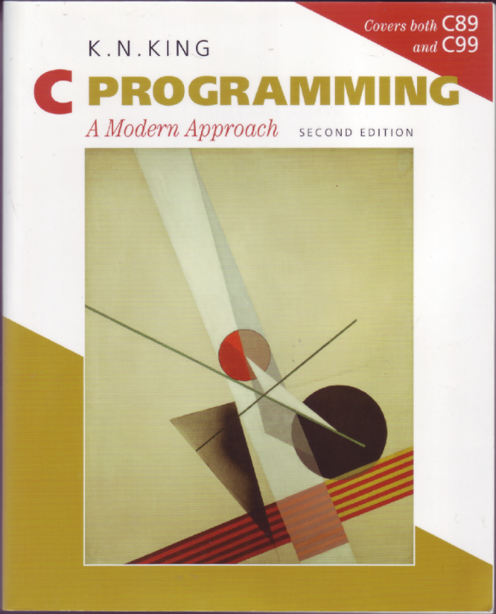
Textbook
C Programming, A Modern Introduction Second Edition
K.N. King
W.W. Norton & Company, 2008
ISBN 978-0-393-97950-3 (pbk.)
Textbook's Web Site:
http://www.knking.com/books/c2/
Errata
Solutions to one-third of the exercises,
marked with a icon in the book

Slide 12
Highlights of Course Objectives
Compile, test, and debug C programs in a Unix environment.
Write programs of moderate size and complexity in the C programming language: functions, strings
Use pointers correctly as function parameters and data structure elements.
Use dynamic memory allocation correctly and appropriately: Linked list

Slide 13
Policies on Projects
You can only discuss ideas or concepts for the projects with others.
Don’t let anyone see or copy your program.
Don’t look at or copy anyone else’s program.
Don’t copy from the internet or any other source.
Write your own code
Copying someone else's work or from the internet will result in a failing grade in the course.
Students who knowingly give their codes to someone else will be penalized equally.

Slide 14
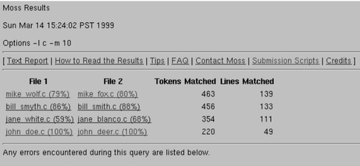
Policies on Projects
We will check for plagiarism.
Moss (A System for Detecting Software Plagiarism)
http://theory.stanford.edu/~aiken/moss/

Slide 15
Materials on Canvas
Announcements
Assignments
Project description and submission
Modules and Files
Syllabus and office hours and lab session links
Frequently Asked Questions
Weekly Folder
Outline of weekly topics, homework exercises
Lecture slides
(Files) Example programs and solutions to in-class exercises
Practice tests and answer keys

Slide 16
Practice and Assignments
In-class Programming Exercises
Homework Exercises
Textbook problems to help you understand concepts
Practice Quizzes
Projects
Completing the in-class exercises before doing projects will save you time

Slide 17
What is your intended major?
Computer Science
Computer Engineering
Other

Slide 18
Success tips for passing with B or Better
Prerequisite knowledge - prepared well from the previous programming course
Attending classes and doing in-class exercises
Attend peer leading sessions and do homework problems
A reasonable course load for the semester
Proactively study before doing projects, exams, and seeking help when needed
Effective study (memorization vs. logical thinking and problem solving)

Slide 19
Unix/Linux Accounts on Student Cluster

Slide 20
Unix/Linux Accounts on Student Cluster
We will compile, test, and debug C programs on a networked Linux/Unix system.
Must have access to Research Computing student cluster system
A cluster computer hosted by Research Computing (RC) at USF
6200 processors running Red Hat Enterprise Linux 6
Contact: rc-help@usf.edu
hostname: sc.rc.usf.edu

Slide 21
Unix Account on Student Cluster
If you registered to this course before Wednesday 8/16, I have sent your netID to research computing and you should already have access to your account.
If you registered to this course after Wednesday 8/16, please email me your netID and section number, I will send the request for you.
Any login questions with your student cluster account, email: rc-help@usf.edu

Slide 22
Introduction to Unix

Slide 23

Why Unix/Linux?
Unix/Linux is everywhere
Mac OS: Unix-based graphical interface OS
Embedded systems in cars, appliances, and devices
Super computers
Mobile phones
The Cloud
Big data

Slide 24
Unix
Unix is an operating system.
An entire family of operating systems such as Linux and BSD (Berkeley Software Distribution).
All versions of Unix are multiuser, multitasking, and can use the same commands
The major components of Unix are the kernel and the command shell.
Kernel: a set of functions that constitute the guts of the operating systems.
Command shell: interpret commands into the proper system action.

Slide 25
Command Shell
Command shell: interpret commands into the proper system action
The most common command shells are Bourne Shell (sh) and Bourne Again Shell (bash)
To find out what shell you are using, on the terminal, type:
echo $SHELL

Slide 26
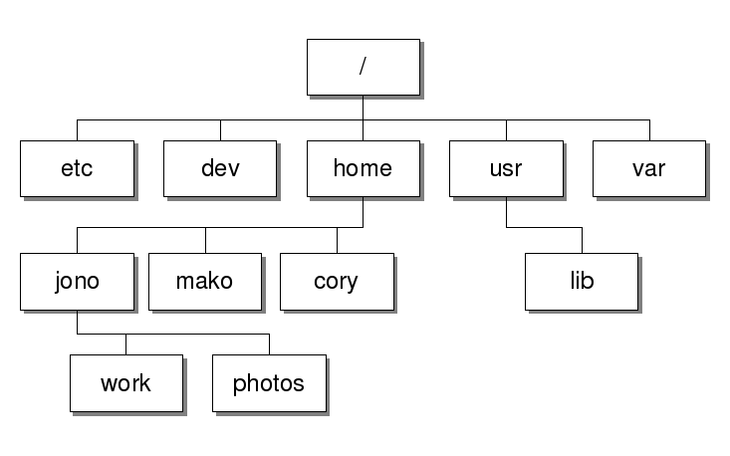
The Unix File System
root
An example Unix file system

Slide 27
Text (Program) Editor
nano (recommended)
Text based
Commands listed at the bottom of the editor
emacs
Graphical interface
vi or vim
We will start to use vi in a few weeks

Slide 28
Chapter 2
C Fundamentals

Slide 29
Objectives
Write a small program to implement a simple algorithm.
Edit, compile, and test your program on a networked Unix system.

Slide 30
Program: Printing Hello World
#include <stdio.h>
int main(void)
{
printf("Hello World!\n");
return 0;
}
This program might be stored in a file named helloWorld.c.
The file name doesn’t matter, but the .c extension is often required.

Slide 31
The General Form of a Simple Program
Simple C programs have the form
directives
int main(void)
{
statements
}
31

Slide 32
Compiling and Linking
Before a program can be executed, three steps are usually necessary:
Preprocessing. The preprocessor obeys commands that begin with # (known as directives)
Compiling. A compiler then translates the program into machine instructions (object code).
Linking. A linker combines the object code produced by the compiler with any additional code needed to yield a complete executable program.

Slide 33
The GCC Compiler
GCC (GNU Compiler Collection) is one of the most popular C compilers.
GCC is supplied with Linux but is available for many other platforms as well.
Using this compiler to compile pun.c:
gcc helloWorld.c

Slide 34
Compiling and Linking Using cc
After compiling and linking the program, gcc leaves the executable program in a file named a.out by default.
Run:
./a.out
The -o option lets us choose the name of the file containing the executable program. To name the executable version of helloWorld.c to :
gcc -o hello helloWorld.c
Run:
./hello

Slide 35
Directives
Directives: Commands that begin with #
By default, directives are one line long
There’s no semicolon or other special marker at the end.
Example:
#include <stdio.h>
<stdio.h> is a header containing information about C’s standard I/O library.

Slide 36
The main Function
main is mandatory and special
it gets called automatically when the program is executed.
main returns a status code
the value 0 indicates normal program termination.
If there’s no return statement at the end of the main function, many compilers will produce a warning message:
warning: control reaches end of non-void function

Slide 37
Statements: Printing Strings
printf function displays a string literal
Characters enclosed in double quotation marks
It doesn’t show the quotation marks.
printf doesn’t automatically advance to the next output line when it finishes printing.
To make printf advance one line
include \n (the new-line character) in the string
printf(“Hello World!\n”);

Slide 38
Comments
A block comment begins with /* and end with */
/* This is a comment */
Block comments may extend over more than one line
/* Name: pun.c
Purpose: Prints a bad pun.
Author: K. N. King */
Line comments ends automatically at the end of a line
// This is a comment
Line comments are safer
No chance that an unterminated comment will accidentally consume part of a program.

Slide 39
Variables and Types
Most programs need to a way to store data temporarily during program execution. These storage locations are called variables.
Every variable must have a type.
C has a wide variety of types, including int and double.

Slide 40
Printing the Value of a Variable
printf can be used to display the current value of a variable.
For example, to display the current value of the height variable, we’d use the following call of printf:
printf("Height: %d\n", height);
%d is a placeholder for integer indicating where the value of height is to be filled in.

Slide 41
Printing the Value of a Variable
There’s no limit to the number of variables that can be printed by a single call of printf:
printf("Height: %d Length: %d\n", height, length);
%d works only for int variables; to print a float or double variable, use %f instead
41

Slide 42
Example Program
Calculate pay for hourly employees

Slide 43
Getting Ready for the semester and next class

Slide 44
Install Terminal Emulator
If you are a Windows user, install any Unix emulator such as Putty and WinSC
Putty (terminal) and WinSCP (file transfer)
https://www.putty.org/
https://winscp.net/eng/download.php
Use the following information to connect:
Hostname: sc.rc.usf.edu
Port: 22
Username: your USF NetID
Password: your USF NetID password

Slide 45
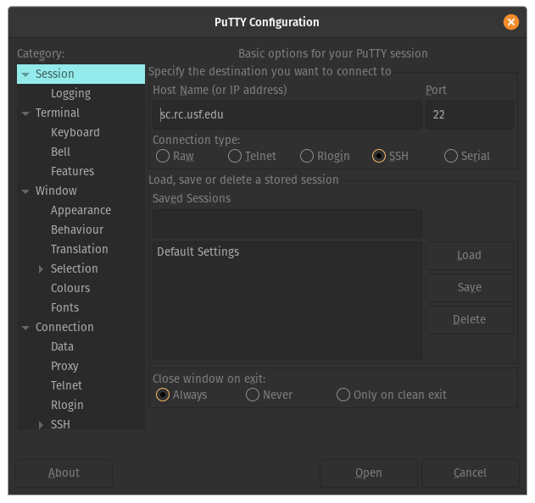
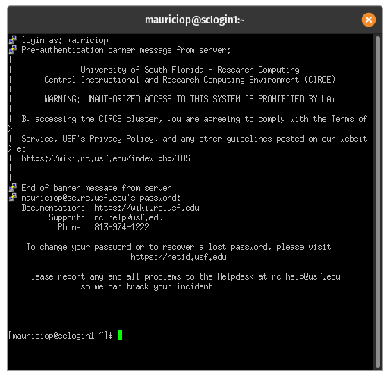
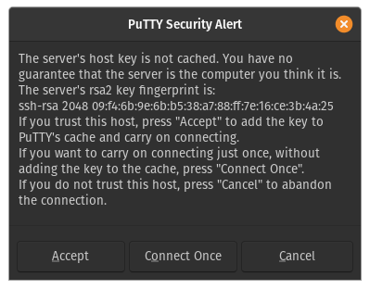
First access to the SC using PuTTY
Insert hostname
Type your username
Type your password
1
Click on 'Open'
2
3
Click on 'Accept'

Slide 46
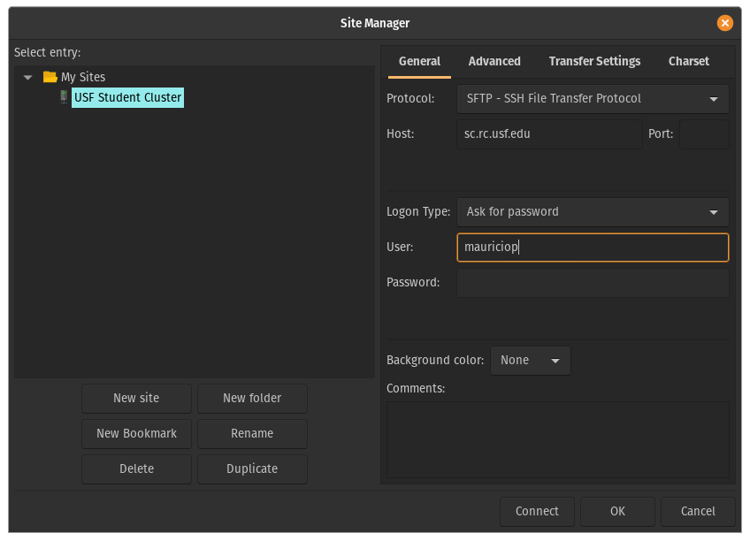
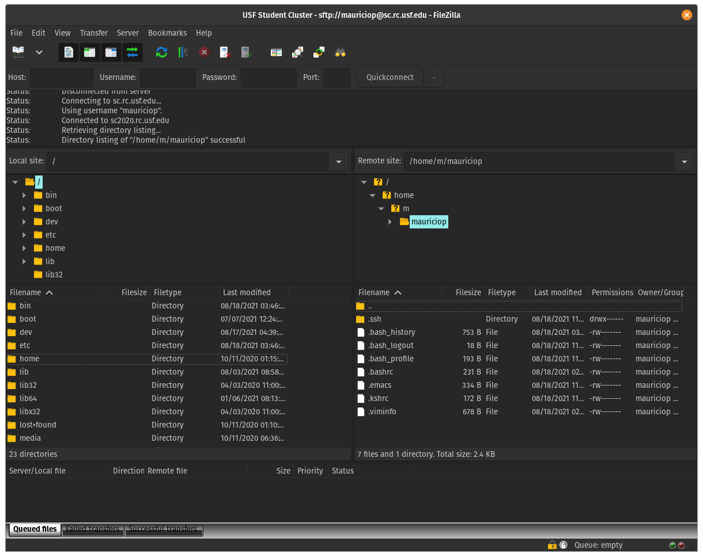
Transfering files from/to the SC
Install FileZilla

Slide 47
Mac Users
For MAC users, you don’t need to install any emulator. MAC OS X includes Secure Shell terminal.
Open Terminal in Applications>Utilities. Then choose the menu Shell>New Remote Connection. Select Secure Shell in the Service section, then click the + button under the Server section. Type in the host name: sc.rc.usf.edu , then put your username in the User field.

Slide 48
Mac Users
In the textfield on the bottom, it should show: ssh yourusername@sc.rc.usf.edu. Click connect.
Download FileZilla for file transfers
https://filezilla-project.org/

Slide 49
Backup IDEs
For Mac
IDE: Xcode, jGRASP
For Windows
IDEs: VScode, CodeBlocks, or jGRASP

Slide 50
Before Next Class
Install
Windows users: Putty and WinSCP
Mac users: FileZilla
Login to the sc(student cluster) to make sure you have access
If you can not access sc, email rc-help@usf.edu
Install a backup IDE

Slide 51
Before Next Class
Bring your laptop to all future classes
Make sure laptop battery is charged
In-class exercises: on your laptop

Slide 52
Summary
What we covered today:
Syllabus and course structure
Material on Canvas
Student Cluster Account and access
Unix/Linux file system
Edit, compile, and test a C program
Getting ready for the semester
Before next class: what you need to do
Questions?

Slide 53
Questions and who to contact
General course questions:
Syllabus, FAQ pages on Canvas
Discussion board on Teams
Course questions: concepts, projects, quizzes ...
Many questions are shared by other students
Monitored by TAs and the instructor – you will get a quicker response on the discussion board
Anybody can post a question and anybody else can reply
Posting any parts of a solution to any parts of a project is considered cheating.
Access student cluster: rc-help@usf.edu

Slide 54
Questions and who to contact
Peer leading sessions:
Concepts, projects, quizzes, homework problems
TA office hours:
Trouble fixing persistent issues with project code
Email the TA who graded your project:
Project grading questions
Email instructor if:
I think someone is cheating on assignments/exams
I have medical/family emergency/feeling overwhelmed/
I have SAS accommodations

Slide 55
First day attendance

